Slide 1
Used car price prediction
By Muhammad saqlain

Slide 2
introduction
Objective: To predict the prices of used cars using various machine learning models and evaluate their performance.
Dataset: Features: Includes fuel_type, mileage, model, transmission ext_col, int_col,brand, model_year, accident, clean_title and engine etc.
Target Variable: `Price`
Dataset Size: 4009 rows and 12 features

Slide 3
Problem statement
Develop a machine learning model to predict used car prices based on features like mileage, engine size, fuel type, and transmission. The goal is to help buyers and sellers make smart decisions by giving them a clear idea of what prices should be.

Slide 4
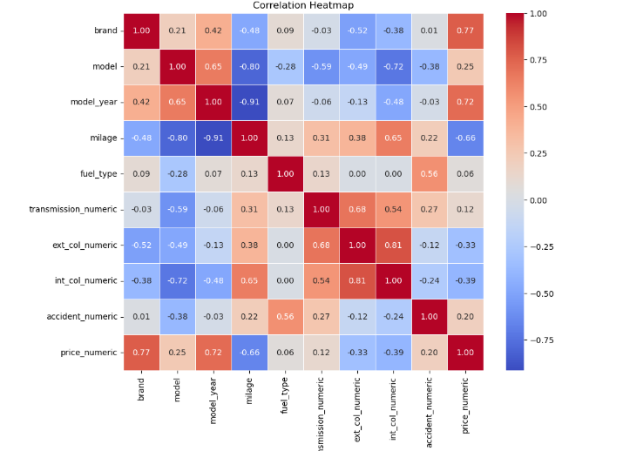
correlation

Slide 5
preprocessing
Label Encoder
Use Label Encoding for: model, engine, accident, clean_title.
Binary Encoding
Use Binary Encoding for: brand, fuel_type, transmission, ext_col, int_col.
Normalization:
MinMax Scaling
for the numerical columns model, milage, engine,accident,clean_title .
Notes:
I am also used the one hot encoding but it cause to memory issue due the high number of columns so that’s why I used binary encoding to tackle this memory problem. Binary encoding change the numerical values into the binary form.

Slide 6
Model explored
Linear regression
Random Forest Regressor
XGBoost
Evaluation Metrics
R-Squared Score
.

Slide 7
R-Squared Score
MODELS | SCORE
Linear Regression | Training R^2 score: 0.955473348930221
Random Forest Regressor | Training R^2 score: 0.9588461218552885
XGBoost | Training R^2 score: 0.964274456682084

Slide 8
conclusion
XGBoost achieved the highest performance with an R-squared score of . Training R^2 score: 0.964274456682084

